Slide 1
Basic Biology

Slide 2
Why to KNOW????
Good to Know
Necessity to Know
☺
☹

Slide 3


Why do we need to know?
Gene, DNA, GBM, Adenocarcinoma
Need to know the
terminology

Slide 4

Benefits --- most important
Ease of communication
Better understanding of what we are trying to achieve
It is always better to have extra knowledge

Slide 5
Digging into the depth

Slide 6
BIOLOGY= Bios+Logia

Slide 7
Hierarchical organization of living system
Level Examples
Organism One single individual
Organ system A specialized functional system of an organism (Digestive System)
Organ A specialized structural system of an organism (Lung, liver)
Tissue A specialized substructure of an organ (skin, blood)
Cell A single cell (bacteria, RBC)
Molecule A single large or small molecule such as a protein, DNA, sugar or fatty acid

Slide 8
Complexity of Living Systems
Organism
1
*
Organ System
1
*
*
1
Tissue
Organ
1
*
Cell
1
*
Molecule

Slide 9
What can be the common structure among systems

Slide 10
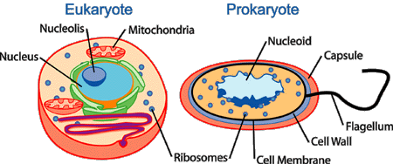
Cell Types
Notes:
Cell: The basic unit of any living organism. It is a small, watery, compartment filled with chemicals and a complete copy of the organism's genome.
Prokaryotic cells, such as bacteria, have a free-floating chromosome that is usually circular and is not enclosed in a nuclear membrane. Instead, the DNA simply exists in a region of the cell called the nucleoid. Prokaryotic cells only have a small range of organelles, generally only a plasma membrane and ribosomes. Eukaryotic cells, on the other hand, have chromosomes that are enclosed in a true nucleus, and are therefore separated from the cytoplasm by the nuclear membrane. Eukaryotic cells also have a wide range of organelles that perform specialized functions.

Slide 11
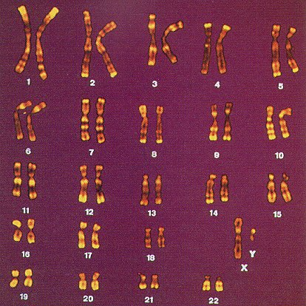
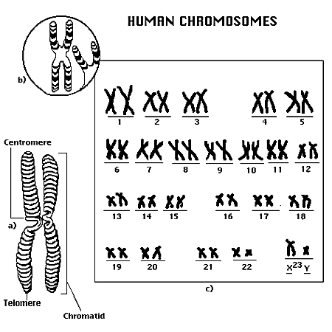
Human Genome
Most human cells contain 46 chromosomes:
2 sex chromosomes (X,Y):
  XY – in males.
  XX – in females.
22 pairs of chromosomes named autosomes.
Notes:
A genome is all the DNA contained in an organism or a cell, which includes the chromosomes plus the DNA in mitochondria (and DNA in the chloroplasts of plant cells).

Slide 12
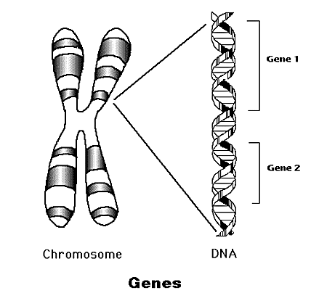
Genetic Information
Gene – basic unit of genetic information. Genes determine the inherited characters.
Chromosomes – A long stretch of coiled strands of DNA and protein containing many genes. Storage units of genes.
Genome – All the DNA contained in an organism or a cell, including chromosomes within the nucleus and DNA in Mitochondria.
Notes:
Gene – basic unit of genetic information. Genes determine the inherited characters.
Genome – the collection of genetic information.
Chromosomes – storage units of genes.

Slide 13
Genotypes Phenotypes
At each locus/position within a chromosome (except for sex chromosomes) there are 2 genes. These constitute the individual’s genotype at the locus.
The expression of a genotype is termed a phenotype. For example, hair color, weight, or the presence or absence of a disease.
Notes:
A genome is all the DNA contained in an organism or a cell, which includes the chromosomes plus the DNA in mitochondria (and DNA in the chloroplasts of plant cells).

Slide 14
Molecular Level

Slide 15
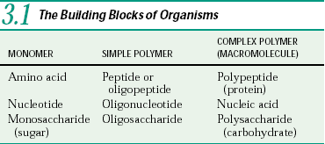
Large Molecules
Monomers → Simple Polymer → Complex Polymer
Notes:
Biology starts at the molecular level

Slide 16
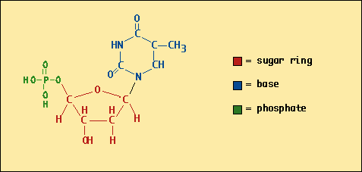
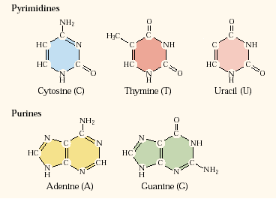
Introduction to Nucleic Acids
DNA/RNA is a long molecule, like a chain, where the links of the chain are pieces called nucleotides (sometimes also called 'bases').
There are four different types of nucleotides in DNA/RNA which are called 'A', 'G', 'C' and 'T‘/’U’.

Slide 17
DNA: Structure
The fundamental building block of DNA is the deoxynucleotide which consist of three components:
  Nitrogenous bases (adenine, guanine, cytosine and thymine) that consist of hetrocyclic rings of carbon and nitrogen atoms.
  A five carbon sugar ( called deoxyribose).
  A phosphate group esterified to the 5th carbon.

Slide 18
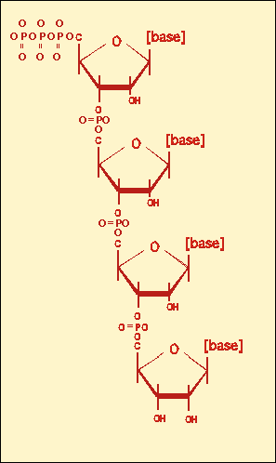
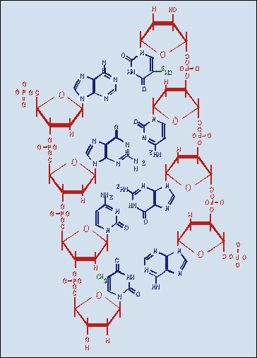
Double-stranded DNA
DNA chains
Notes:
Backbone consists of alternating Pentose Sugar and Phosphates
→ Sugar → Phosphate→ Sugar→ Phosphate – Base Stacking
The nucleotides are joined by Phosphodiester linkages between the sugar of one nucleotide and the phosphate of the next
Phosphate group links 3’ Carbon of one group with 5’ carbon of another group
Bases are attached to the Sugar and project from the chain
Double Stranded Helix
Two polynucleotide strands held together by H-bonding between the Nitrogenous bases – Base Pairing
Two strands run in opposite directions – Anti-parallel orientation
Necessary for strands to fit together in 3-D space
The DNA strands are assembled in the 5′ to 3′ direction and, by convention, we "read" them the same way

Slide 19
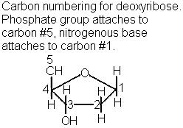
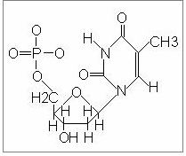
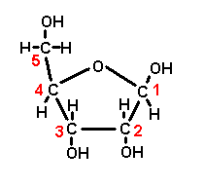
Chemical Structure
Notes:
The carbon atoms in the deoxyribose sugar are numberd clockwise fron the oxygen 1 thought 5’. The attachments are numbered according to the carbon atoms they are bonded. (5’ phosphate or 3’ hydroxly). The bases are attached to the 1st carbon.
The deoxynucleotides are strung together by phosphodiester bridge between 5’ phospate of one deoxynucleotide and 3’ hydroxyl of the sugar of next.

Slide 20
Antiparallel Strands
Antiparallel Strands
The two strands of DNA are also antiparallel(run in opposite directions) to one another.
  A strand of DNA can have the direction 5'-3' or 3'- 5'. One strand in the DNA molecule is 5'-3' and the other strand is 3'-5'. A DNA strand is assigned direction based on what is found at the end of the strands.
    The end of the strand with a free phosphate is the 5' end because phosphate attaches to the 5' carbon of the sugar.
    The end with a free OH group is the 3' end because the OH group is attached to the 3' carbon of the sugar.
Notes:
The phosphate have a negative charge and are positioned on the outside of the molecule with the bases on the inside. The alternate sugar and phosphate make the sugar phosphate back bone.

Slide 21
The Central Dogma
The central dogma of molecular biology describes the two-step process, transcription and translation, by which the information in genes flows into proteins:
        DNA → RNA → protein.
Transcription is the synthesis of an RNA copy of a segment of DNA. RNA is synthesized by the enzyme RNA polymerase.
Notes:
Transcription is the process of making RNA from DNA.
Since DNA and RNA use the same four letter alphabet made of the bases A,C,T, and G, (except RNA uses U instead of T), copying a gene from DNA onto RNA simply transcribes the instructions for making a protein. It does not translate them into another language or alphabet.
In eukaryotes, DNA remains in the nucleus, but proteins are built in the cytoplasm. So the instructions contained in DNA must be transcribed onto an RNA (ribonucleic acid) molecule, which moves into the cytoplasm and serves as the template for making a protein.
Unlike replication, which makes a copy of a complete chromosome, transcription only makes a copy of the gene that is to be expressed as a protein.

Slide 22
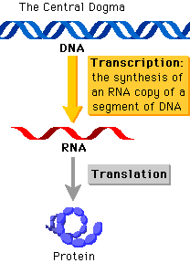
Central Dogma of Life

Slide 23
Types of RNA’s
There are 4 types of RNA, each encoded by its own type of gene:
• mRNA - Messenger RNA: Encodes amino acid sequence of a polypeptide.
• tRNA - Transfer RNA: Brings amino acids to ribosomes during translation.
• rRNA - Ribosomal RNA: With ribosomal proteins, makes up the ribosomes, the organelles that translate the mRNA.
• snRNA - Small nuclear RNA: With proteins, forms complexes that are used in RNA processing in eukaryotes. (Not found in prokaryotes.)
Notes:
Different Genes for Different RNAs
There are 4 types of RNA, each encoded by its own type of gene.
The genomic DNA contains all the information for the structure and function of an organism.
In any cell, only some of the genes are expressed, that is, transcribed into RNA.

Slide 24

Basic Structure of a Protein-Coding Gene
A protein-coding gene consists of a promoter followed by the coding sequence for the protein and then a terminator.
The promoter is a base-pair sequence that specifies where transcription begins.
The coding sequence is a base-pair sequence that includes coding information for the polypeptide chain specified by the gene.
The terminator is a sequence that specifies the end of the mRNA transcript.

Slide 25
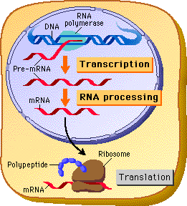
Transcription and Translation in Cells
Eukaryotic Cell
Transcription and translation are spatially and temporally separated in eukaryotic cells; that is, transcription occurs in the nucleus to produce a pre-mRNA molecule.
The pre-mRNA is typically processed to produce the mature mRNA, which exits the nucleus and is translated in the cytoplasm. Eukaryotic Cell

Slide 26
Translation: Gene to Protein
Translation can be defined as Proteins synthesized from a DNA template or Translation – of the genomic sequence into protein sequence.
The basic building block of a protein is the amino acid.
Notes:
Gene to Protein: Translation (Protein Synthesis)

Slide 27
Molecular Components of Translation
mRNA (Messenger RNA): Consists of leader, reading frame, and trailer sequences.
Ribosomes: the organelles on which the mRNA is translated, consist of two subunits, each of which contains rRNA and ribosomal proteins.
tRNAs: bring amino acids to the ribosomes during translation to be assembled into polypeptide chains.
Notes:
mRNAs vary in length.
Sequences of mRNAs vary because amino acid coding sequences (reading frames) differ, and because leader and trailer sequences differ.
In translation, the mRNA passes through the ribosome, where the codons are recognized by tRNAs carrying the specified amino acids.
Each ribosomal subunit consists of rRNA (ribosomal RNA, encoded by rRNA genes) and ribosomal proteins.
tRNAs are encoded by tRNA genes.
All tRNA molecules are similar in size and shape.
All tRNAs have CCA at the 3' end to which the amino acid attaches.
At the other "end" of the tRNA molecule is the anticodon, which, during translation, "reads" the matching codon on the mRNA.

Slide 28

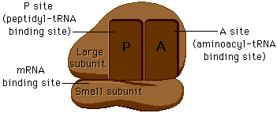
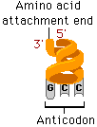
Molecular Components of Translation
mRNA
Ribosomes
tRNA

Slide 29
The Genetic Code
The language of RNA is translated to the language of protein: The genetic code is a triplet code in which three nucleotides in RNA specify one amino acid in protein.
RNA consists of four "letters": A, U, G, and C.
Protein consists of 20 "letters": the amino acids.
Notes:
How can RNA code for protein?
• If 1 RNA base codes 1 amino acid, RNA could code for only 4 amino acids. Not enough coding capacity for all 20 amino acids.
• If 2 RNA bases code for 1 amino acid, RNA could code for 42 = 16 amino acids. Still not enough coding capacity for 20 amino acids.
• If 3 RNA bases code for 1 amino acid, RNA could code for 43 = 64 amino acids. More than enough coding capacity for 20 amino acids.

Slide 30
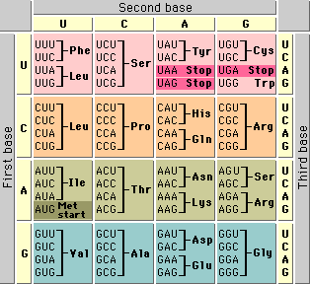


The Genetic Code

Slide 31
Some terms you need to know…
Gene: A gene is the basic unit of heredity in a living organism.
DNA: The molecules inside cells that carry genetic information and pass it from one generation to the next.
RNA: RNA transmits genetic information from DNA to proteins produced by the cell.
Protein: Proteins are fundamental genetically encoded components of living cells with specific structures and functions dictated by amino acid sequence.

Slide 32
Some terms used
Participant: An individual from whom a specimen is collected.
Microarray: A piece of glass or plastic on which different samples have been affixed at separate locations in an ordered manner thus forming a microscopic array. The samples are usually DNA fragments but may also be antibodies, other proteins, or tissues.
Specimen/Sample: A part of a thing, or of several things, taken to demonstrate or to determine the character of the whole, e.g. a substance, or portion of material obtained for use in testing, examination, or study; particularly, a preparation of tissue or bodily fluid taken for examination or diagnosis.

Slide 33
Cancer Research
What is Cancer?
Why is so much research going on in the field?
How is the research (may or may not be cancer) carried out?
Where is the GAP?
Cancer Biomedical Informatics Grid

Slide 34

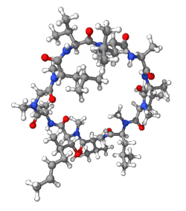
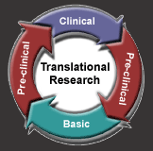
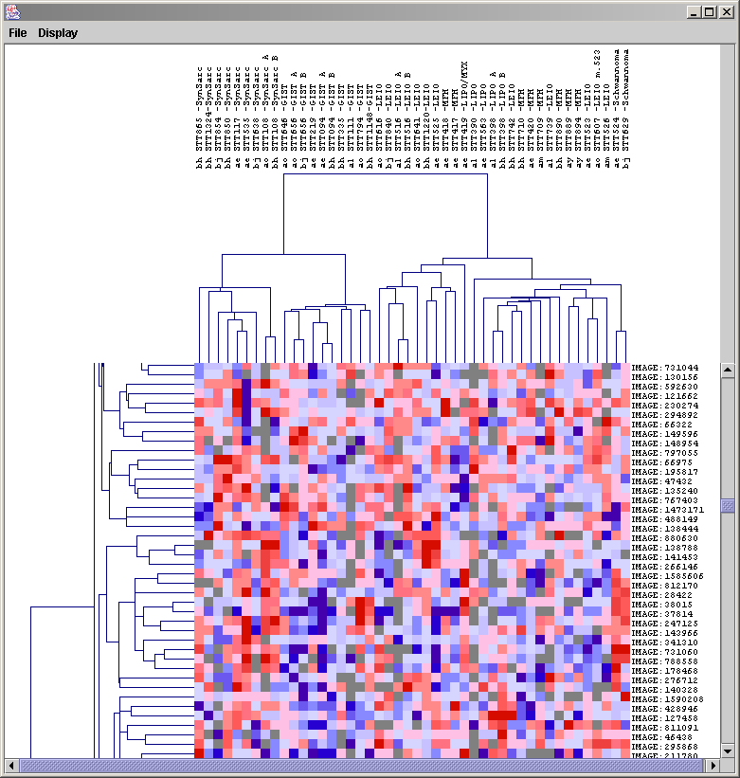
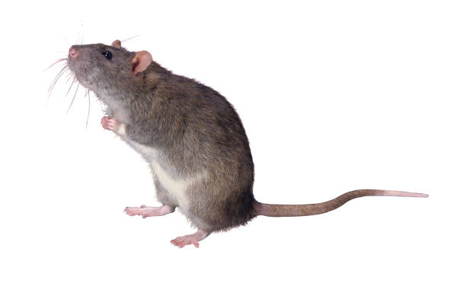
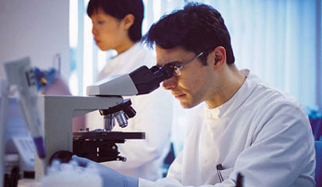
Translational Research

Slide 35
How this session helps?

Slide 36
Tissue Banking Repository
Specimens collected from variety of sources.
Information about the specimen should be maintained accurately

Slide 37
Clinical Investigation Data Exploration Repository
Data collected from the various hospitals currently in WashU and BJC. Scope is ever increasing
Need to maintain infinite patient records

Slide 38
Microarray data Repository and analysis tools
Binary files generated as a result of the experiment
Once an experiment is done need to maintain what was done, how it was done and what all were the ingredients of it.
The files generated need to be analyzed which is impossible to do manually.

Slide 39
Clinical Studies Data Management System
Deals with Clinical study data.
Major problem is there is no uniformity in the type of data.
Huge amounts of data which needs to be maintained in a queriable format

Slide 40
B2B
Solving the problem of reducing the gap from:
BENCH to BEDSIDE
Bridge the gap between a bench scientist and a clinician.

Slide 41
Why are all these tools required?
Help in research.
To make sense out of the huge amount of data.
To help the research community.

Slide 42
This makes “US” a very vital resource in cancer research

Slide 43
Thank You

